Slide 1
Micro Bond geographic Prediction
Gloria Shen, Junfeng Li, Yuehai Shen

Slide 2
The Original Problem
Micro bond is a new investment platform which will issue segment of municipal bond and allow more individuals to afford.(the minimum limit of purchasing municipal bond is $5000, and individuals can buy as low as $5 with Micro Bond.)
The Agora company asks to come up with the cities that will be a good choice to issue the Micro Bond. Our primary goal is to predict the likelihood of success for issuing Micro Bond in different cities.

Slide 3
General Approach
research/Identifying the problem
collect the original data
If we had get any historical data from previous phase, we can build our prediction model.
We will give our final report based on the modeling and dataset.
Data collecting
Building model
Final Presentation
Data cleaning
Validation
Cleaning the data we have got and insert into database.
Since our expect dataset will be extremely small, we will use LOOCV for validation.

Slide 4
Dataset (The challenge we face)
No historical data. The data provided by the company is informal and only about 20 records are somehow helpful.
Only a few similar products available in the US market. It is a new kind of investment that different than traditional investment, like stock and municipal bond.
The only similar product MINI BOND(not exactly the same as the mentioned MICRO BOND) was sold in UK, but just got banned last year for security issues.
Most data related to the investment preference or geographic trade history are private. Purchasing this kind of data(APIs) is expensive and unaffordable. Even though if we can get this kind of data in the future, we are afraid that the prediction would not be accurate because it is different than other investment methods.

Slide 5
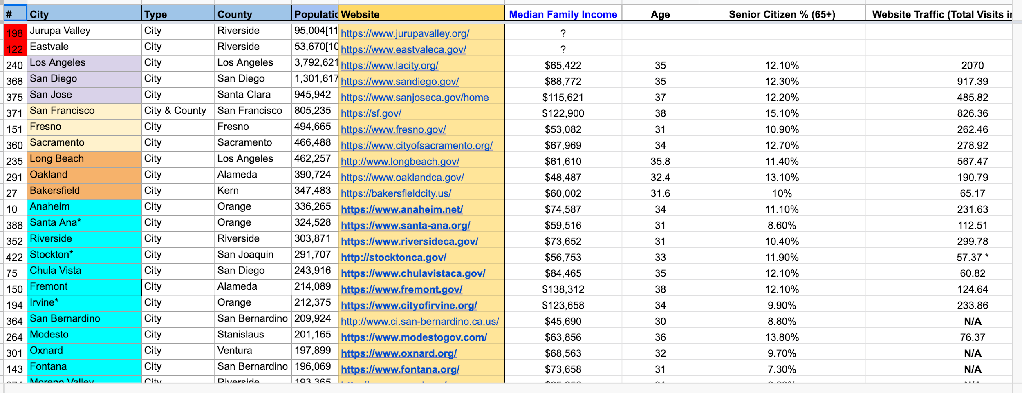
Dataset
200 Observations
6
features
10% Missing
No prediction variable

Slide 6
Machine Learning Model
Sentiment Analysis
BERT - Bidirectional Transformers for Language
Prediction
Linear Regression
Random Forest
Existing data: Clustering(unsupervised learning)

Slide 7
Validation
K-fold Cross validation.
For unsupervised model, we will analysis them case by case.

Slide 8
Visualization
Geography:
Map
Choropleth
Sentiment Analysis:
Words cloud

Slide 9
Software
Python - Jupyter Notebook/Colab
Github - Collaboration
Psql - Store data
Tableau - Data visualization

Slide 10
Timeline
Week 9-10 Winter: Data collection; Finalizing ideas of project
Week 1-2 Spring: Data collection and wrangling
Week 3-4 Spring: Train different ML models
Week 5-6 Spring: Train different ML models
Week 7-8 Spring: Test models and validation
Week 9-10 Spring: Final report and data visualization

Slide 11
Questions

